Slide 1

Many hands make light work
.......
THE ART OF EFFECTIVE TEAMWORK
Presented by: Truong Huy Phuoc

Slide 2





Work Efficiency

Slide 3
TeamWork Efficiency

Slide 4
TeamWork Efficiency

Slide 5

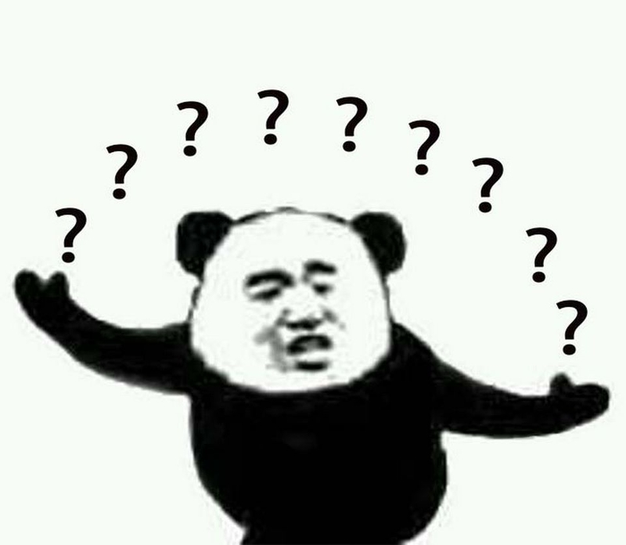
THE ART OF EFFECTIVE TEAMWORK

Slide 6



The 4 Golden Rules

Slide 7



The 4 Golden Rules
 | Rule 1: Clear & Shared Goals

Slide 8
The 4 Golden Rules
 | Rule 1: Clear & Shared Goals
 | Rule 2: Right Person, Right Place

Slide 9
The 4 Golden Rules
 | Rule 1: Clear & Shared Goals
 | Rule 2: Right Person, Right Place
 | Rule 3: Open Communication & Active Listening

Slide 10
The 4 Golden Rules
 | Rule 1: Clear & Shared Goals
 | Rule 2: Right Person, Right Place
 | Rule 3: Open Communication & Active Listening
 | Rule 4: Personal Accountability

Slide 11




Digital Tools
ClickUP
Trello

Slide 12


Digital Tools
Slack
Google Workspace

Slide 13

Digital Tools
Discord

Slide 14

Digital Tools
Discord

Slide 15

Digital Tools
Discord

Slide 16
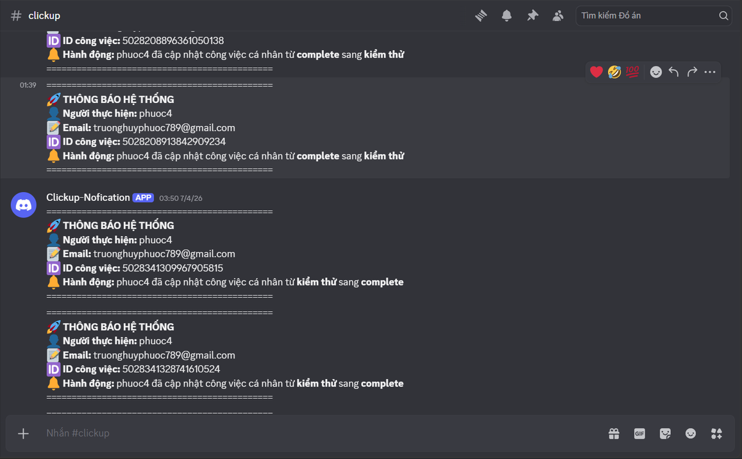
Digital Tools
Discord

Slide 17
THANK YOU!

